Slide 1
PROGRAMMING IN JAVA

Slide 2
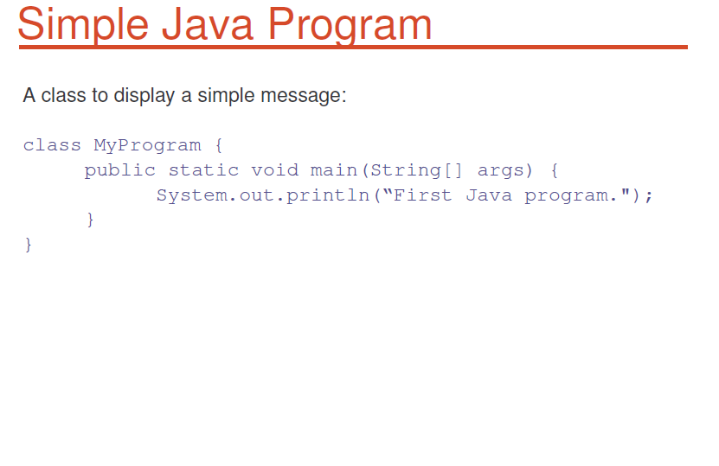
SIMPLE JAVA PROGRAM

Slide 3
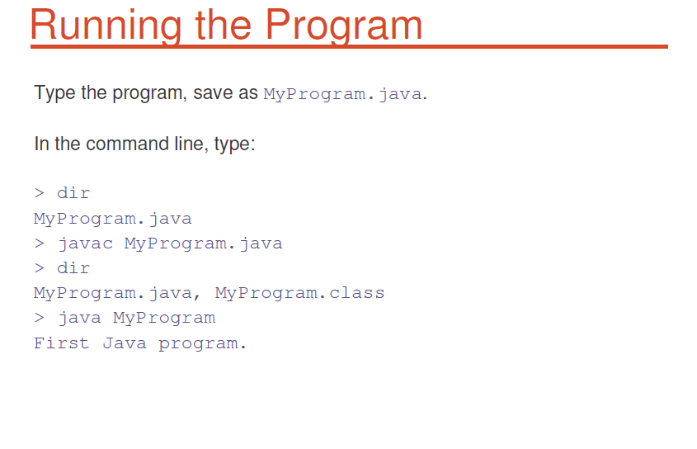
JAVA PROGRAM EXECUTION

Slide 4
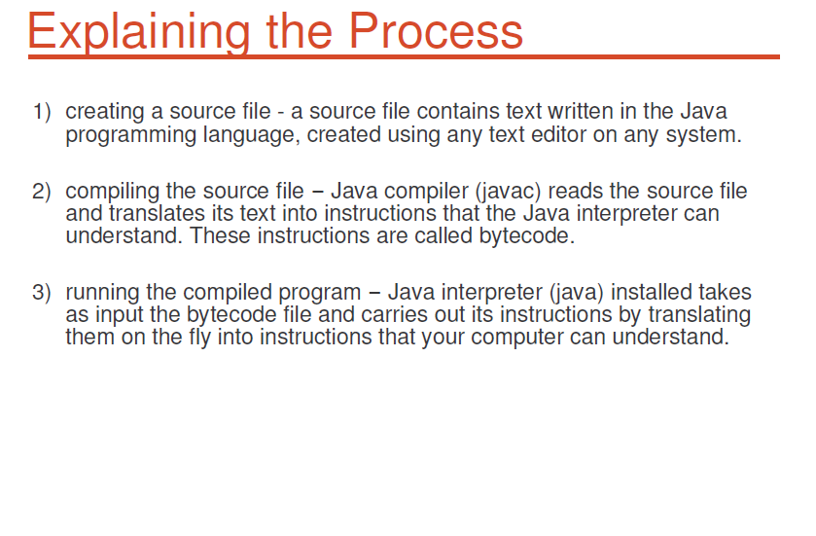

Slide 5
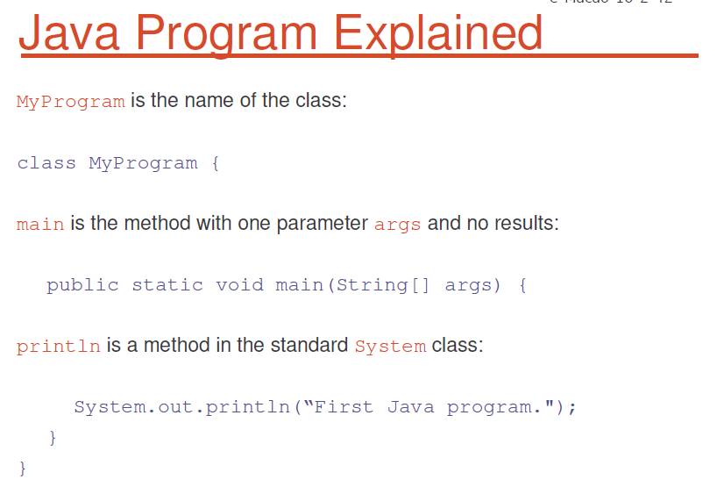

Slide 6
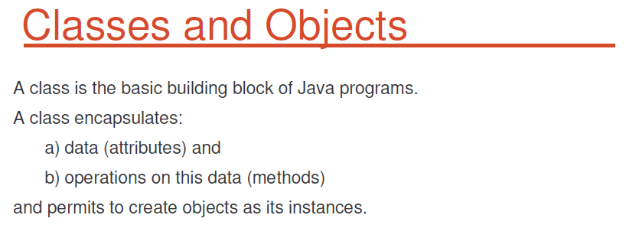

Slide 7
